Slide 1
Full-Resolution Residual Neural Networks for Semantic Segmentation in Street Scenes
Authors: Tobias Pohlen, Alexander Hermans, Markus Mathias, Bastian Leibe
6 Dec 2016

Slide 2
Outline
What is a Semantic image segmentation?
How does it work?
Experimental details and results
Conclusions

Slide 3
Semantic image segmentation

Slide 4
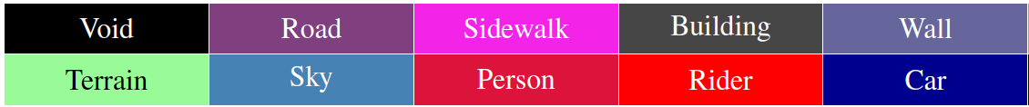

Semantic image segmentation

Slide 5
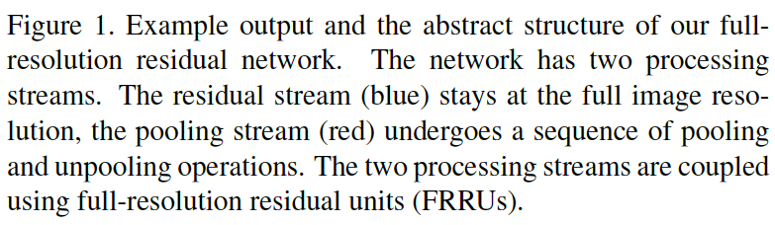
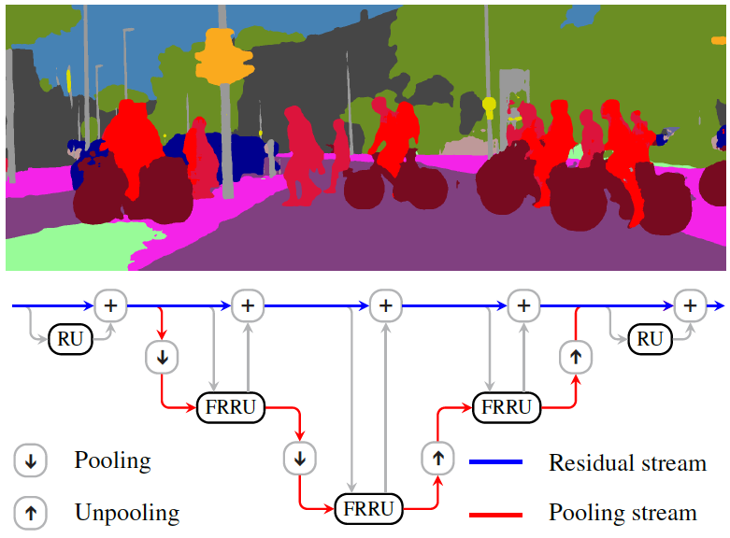
How does it work?
Full-Resolution Residual Neural Networks
Two streams
Understanding large-scale relationships of image elements
Produces feature maps at full image resolution, precise boundary adherence

Slide 6
How does it work?
Convolutional NN
Residual NN

Slide 7
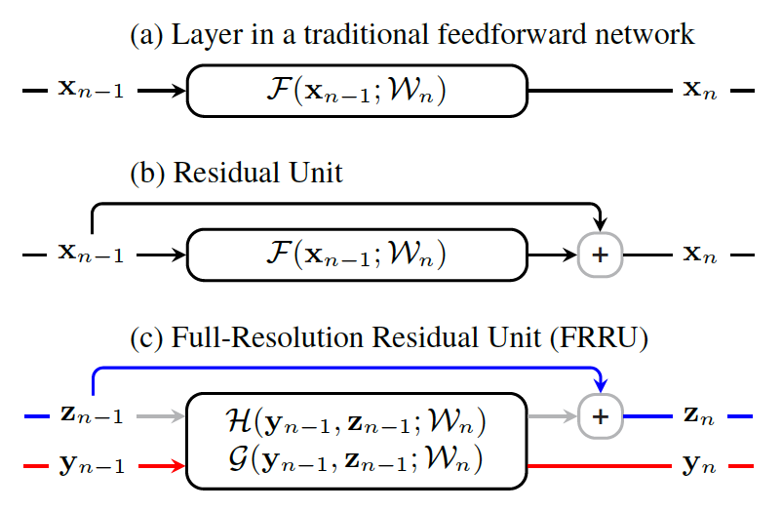
How does it work?

Slide 8
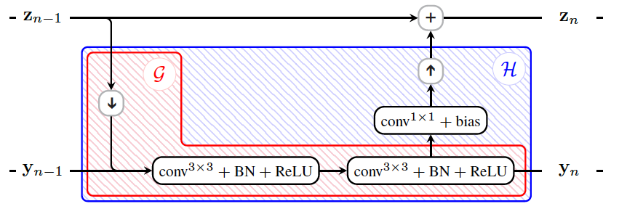
Experimental details and results

Slide 9
Experimental details and results
Cost function: Cross-entropy loss
Database: Cityscapes (which has images recorded in 50 different cities, i.e. Urban street scenes)
Training samples: 2975 images
Validation samples: 500 images
Test samples: 1525 images
Image resolution: 1024 x 2048 pixels (original)
Image resolution: 256 x 512 pixels (training process)
Some comments
Use of pre-trained models
Boundary detection
Very memory intensive

Slide 10
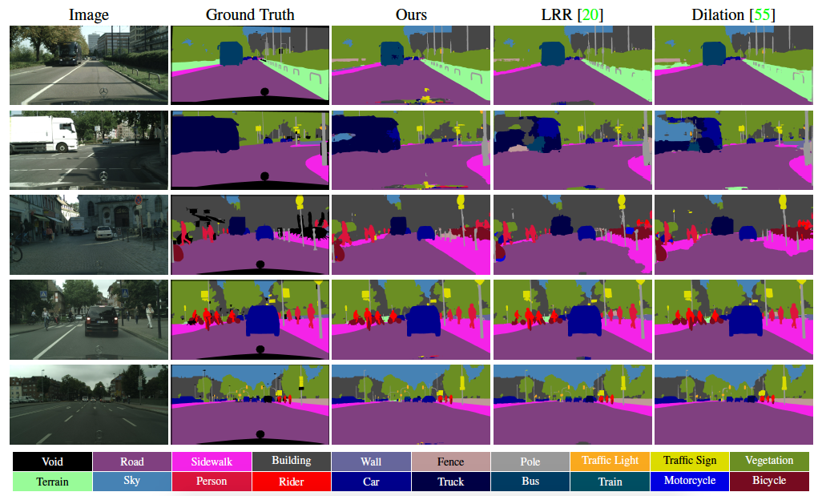
Experimental details and results
Intersection-over-union
score of 71.8%

Slide 11
Conclusions
Can be trained from scratch
High model performance

